Slide 1
The PTC story...

Slide 2
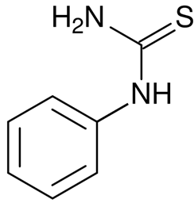
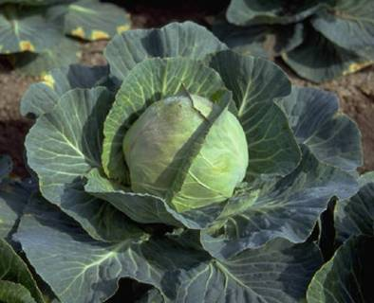
What is PTC?
Phenylthiocarbamide
PTC has a chemical group similar to that found in Brassica vegetables, like Brussels sprouts and cabbage and in some wild poisonous plants
Notes:
If they want to know it’s called an isothiocyanate group
Ask the group who likes Brussels Sprouts and cabbages? Hands-up.
Keep your hand up if you’re a PTC taster and you like Brussels Sprouts. Generally, PTC tasters do not like sprouts.

Slide 3
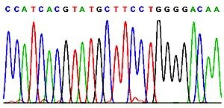
Why can some people taste PTC, and some not?
Ability to taste, or not taste PTC is mostly due to changes in a gene, which encodes one of the bitter taste receptors on your tongue.
A strong taster and a non-taster will have a different DNA code

Slide 4

TAS2R38 gene – DNA code
cctttctgcactgggtggcaaccaggtctttagattagccaactagagaagagaagtaga atagccaattagagaagtgacatcatgttgactctaactcgcatccgcactgtgtcctat gaagtcaggagtacatttctgttcatttcagtcctggagtttgcagtggggtttctgacc aatgccttcgttttcttggtgaatttttgggatgtagtgaagaggcagccactgagcaac agtgattgtgtgctgctgtgtctcagcatcagccggcttttcctgcatggactgctgttc ctgagtgctatccagcttacccacttccagaagttgagtgaaccactgaaccacagctac caagccatcatcatgctatggatgattgcaaaccaagccaacctctggcttgctgcctgc ctcagcctgctttactgctccaagctcatccgtttctctcacaccttcctgatctgcttg gcaagctgggtctccaggaagatctcccagatgctcctgggtattattctttgctcctgc atctgcactgtcctctgtgtttggtgcttttttagcagacctcacttcacagtcacaact gtgctattcatgaataacaatacaaggctcaactggcagattaaagatctcaatttattt tattcctttctcttctgctatctgtggtctgtgcctcctttcctattgtttctggtttct tctgggatgctgactgtctccctgggaaggcacatgaggacaatgaaggtctataccaga aactctcgtgaccccagcctggaggcccacattaaagccctcaagtctcttgtctccttt ttctgcttctttgtgatatcatcctgtgctgccttcatctctgtgcccctactgattctg tggcgcgacaaaataggggtgatggtttgtgttgggataatggcagcttgtccctctggg catgcagccatcctgatctcaggcaatgccaagttgaggagagctgtgatgaccattctg ctctgggctcagagcagcctgaaggtaagagccgaccacaaggcagattcccggacactg tgctgagaatggacatgaaatgagctcttcattaatacgcctgtgagtcttcataaatat
gcc
Chromosome 7

Slide 5
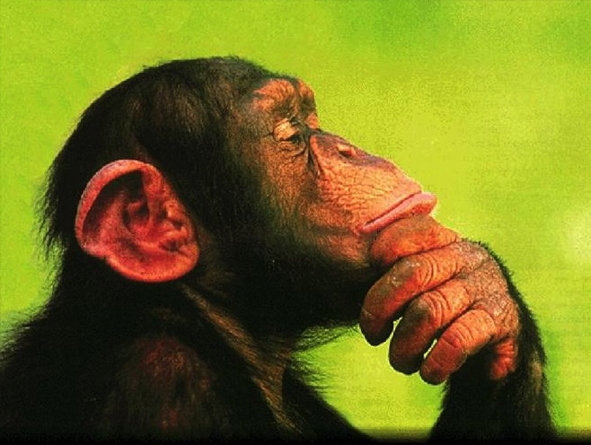
Genotype and phenotype
How does our TAS2R38 gene makes us a PTC taster or non-taster?

Slide 6
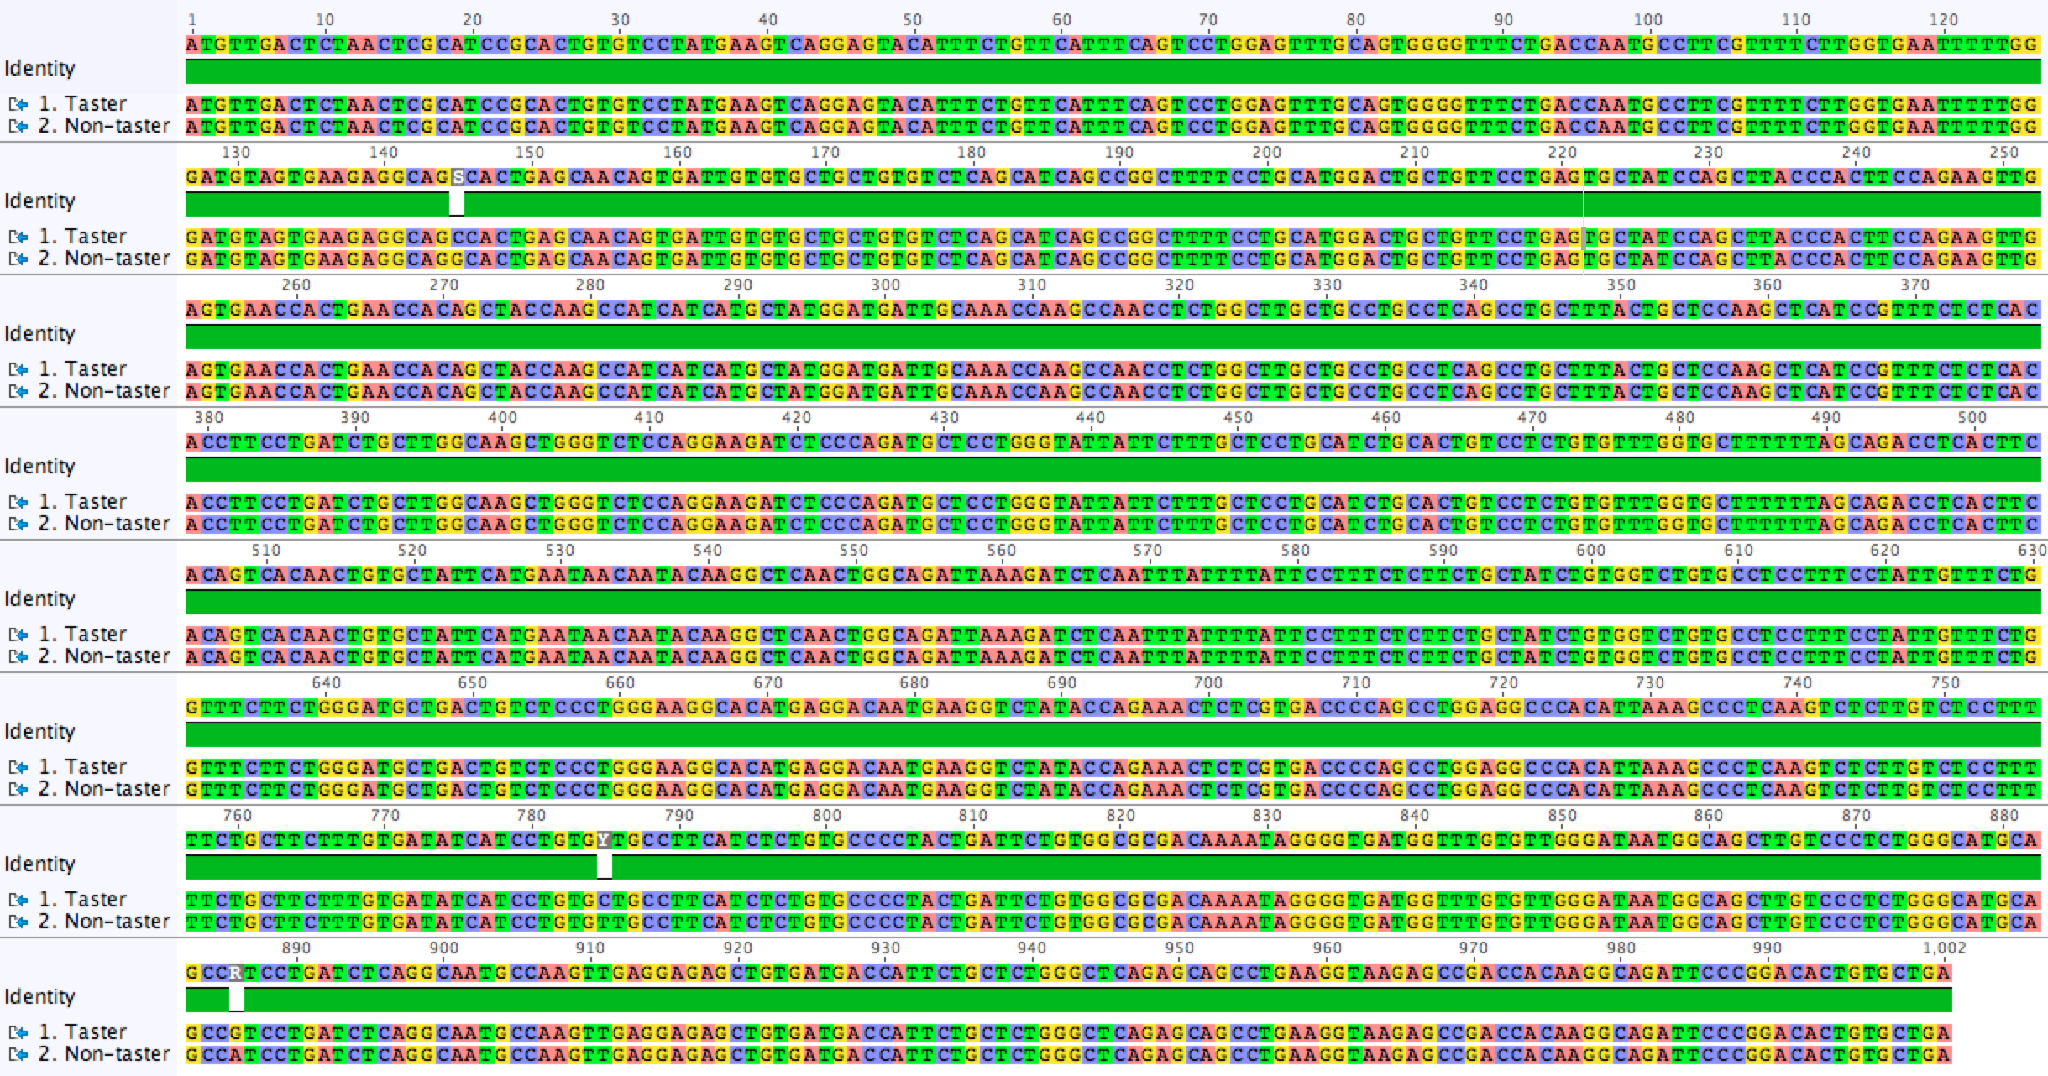
3 common variants in TAS2R38 gene between tasters and non-tasters (white marks)
Notes:
This is the DNA sequence for most of the TAS2R38 gene. It shows the sequence from a taster, aligned with that from a non-taster. The gaps in the green ‘graph’ are three letters of the DNA code that are commonly different between PTC tasters and non-tasters (positions: 145, 785 and 886).

Slide 7
TAS2R38 variants
This workshop looks at one DNA variation involved in PTC tasting
Human TAS2R38 DNA (taster)
Human TAS2R38 DNA (non- taster)
Human PTC tasters have a C at position 145
Human PTC non-tasters have a G at position145
Notes:
Our work today looks at just one of these changes. It is very common for tasters to have a C at position 145 of the gene, and for non-tasters to have a G in this position.

Slide 8
TAS2R38 gene – DNA code
cctttctgcactgggtggcaaccaggtctttagattagccaactagagaagagaagtaga atagccaattagagaagtgacatcatgttgactctaactcgcatccgcactgtgtcctat gaagtcaggagtacatttctgttcatttcagtcctggagtttgcagtggggtttctgacc aatgccttcgttttcttggtgaatttttgggatgtagtgaagaggcaggcactgagcaac agtgattgtgtgctgctgtgtctcagcatcagccggcttttcctgcatggactgctgttc ctgagtgctatccagcttacccacttccagaagttgagtgaaccactgaaccacagctac caagccatcatcatgctatggatgattgcaaaccaagccaacctctggcttgctgcctgc ctcagcctgctttactgctccaagctcatccgtttctctcacaccttcctgatctgcttg gcaagctgggtctccaggaagatctcccagatgctcctgggtattattctttgctcctgc atctgcactgtcctctgtgtttggtgcttttttagcagacctcacttcacagtcacaact gtgctattcatgaataacaatacaaggctcaactggcagattaaagatctcaatttattt tattcctttctcttctgctatctgtggtctgtgcctcctttcctattgtttctggtttct tctgggatgctgactgtctccctgggaaggcacatgaggacaatgaaggtctataccaga aactctcgtgaccccagcctggaggcccacattaaagccctcaagtctcttgtctccttt ttctgcttctttgtgatatcatcctgtgctgccttcatctctgtgcccctactgattctg tggcgcgacaaaataggggtgatggtttgtgttgggataatggcagcttgtccctctggg catgcagccatcctgatctcaggcaatgccaagttgaggagagctgtgatgaccattctg ctctgggctcagagcagcctgaaggtaagagccgaccacaaggcagattcccggacactg tgctgagaatggacatgaaatgagctcttcattaatacgcctgtgagtcttcataaatat
gcc
Can you tell if this DNA is from a PTC taster or
non-taster?
Chromosome 7
Notes:
So remember that this is the part of the gene that we are amplifying by PCR. So, our variable letter (or SNP) is shown here in the red box. This means that although it’s nucleotide 145 of the gene, it’s letter 44 in the PCR fragment.
No, we can’t tell if this is from a taster or non-taster without seeing the DNA sequence from their other chromosome. However, we can tell that it’s not from a homozygous taster.

Slide 9
The genetics of bitter tasting
It’s important to remember that people have 2 copies of each chromosome. So, at nucleotide 145 they could have two CCs, two GGs or one of each.
145G = non-taster
145C = taster
TAS2R38 locus
Homozygous non-taster
Homozygous taster
Heterozygous taster
The ability to taste PTC is dominant
– therefore PTC tastes bitter to heterozygotes

Slide 10


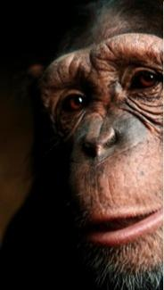
What is the evolutionary story of PTC?
Humans can be:
PTC tasters
PTC non- tasters
Chimps are our closest relative, we evolved from a shared common ancestor over 5 million years ago.
Human and chimp genomes are about 98% identical
Do you think chimps can taste PTC?
Notes:
Ask students to vote on whether they think all chimpanzees can taste PTC, whether they think no chimps can taste PTC or whether some can and some can’t. Ask them to justify their thoughts. Try to make a link between what they say and the hypothesis on the next slide.

Slide 11
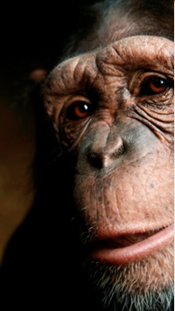
PTC and chimpanzees
Just like humans, some chimps are PTC tasters and some are non-tasters

Slide 12
How could we explain the results?
FACT: Human can be either tasters or non-tasters
FACT: Chimpanzees can be either tasters or non-tasters
FACT: Humans and chimpanzees who cannot taste PTC have changes at different locations in their TAS2R38 gene.
Chimpanzee
Human
HYPOTHESIS 2: The common ancestor of humans and chimpanzees was only a PTC taster. Since then, humans and chimpanzees have evolved separately, with some of each species becoming non-tasters.
T
t
t
T
Common ancestors
(PTC taster [T])
Notes:
So, all of the evidence so far today supports this hypothesis.

Slide 13
Humans and chimps have undergone convergent evolution
HYPOTHESIS 2
Chimp
Human
T
t
t
T
Common ancestor
(PTC taster)
Notes:
So, we know from the DNA sequences that human and chimp non-tasters have differences in different location in the TAS2R38 gene. This paper also showed that the common ancestor of chimps and humans was likely to be a PTC taster. Therefore, the two species have evolved independently to acquire the same characteristic – inability to taste PTC. This is called CONVERGENT evolution.

Slide 14
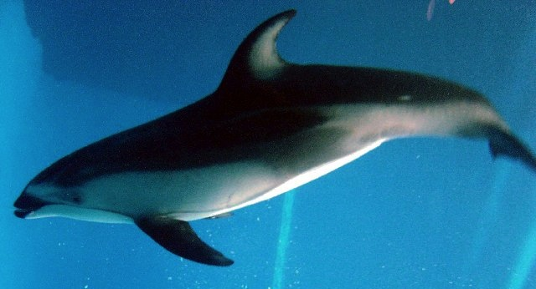

What is convergent evolution?
Two species acquire the same traits over time through random, independent mutations
Implies that the trait is beneficial
Notes:
Dolphins and sharks have very similar body shapes, positioning of fins and colouring of their bodies. REMEMBER all of these changes are results of random mutations over a very long time. There will also have been mutations which weren’t beneficial, but it is less likely that these will have been passed on through as many generations. Survival of the fittest.

Slide 15
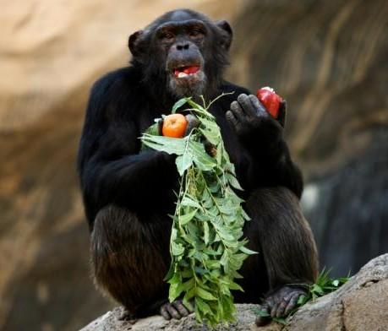
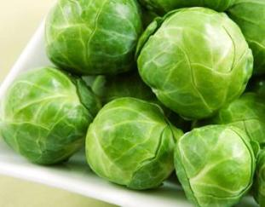
Is it beneficial to be able to taste PTC?
Nobody knows the answer to this question yet!
The theories…
Do PTC non – tasters eat more green vegetables which are beneficial in preventing cancer?
Do PTC tasters eat less poisonous food in the wild?
Are these traits still advantageous for humans?
Notes:
The scientific research in this area is still ongoing – but there are theories being tested. Some scientists think that PTC tasters will have survived to reproduce because they won’t have eaten too many poisonous plants. Non-tasters might have an advantage because they will eat more green vegetables which keep them healthier and help to prevent diseases such as cancer. Are either of these traits advantageous for humans today? If so, will the effect be intense enough to have an impact upon human evolution?

Slide 16
Are we half way through a process of
evolutionary change?
OR
Is balancing selection occurring?
Notes:
One big question still remains: In another few million years will we all be non-tasters of PTC, or is there some advantage to maintaining both alleles within the human population?

